Slide 1
Contents
For 2nd layer deep diving page
DEI Dashboard
Mark Zhang

Slide 2
K8

Slide 3

Title
Proficiency: 4th grade math Proficiency and above
The proportion of CPS 4th graders at or above math proficiency by race/ethnicity
4th grader math proficient CHI 2021 / Total 4th grader CHI 2022
Vs. 4th grader math proficient US 2021 / Total 4th grader US 2020
Charts
Bullet points
What does the data tell?
In CPS 4th grade, White students have the highest math proficiency rate,1.1 times higher than Asians, 1.8 times higher than Hispanics, and 2.8 times higher than black.
The proportion of math proficient students in 4th grade is noticeably lower in CPS than the national average across all ethnic groups.
4th grade math proficiency or above
Race/Ethnic group | Population Size | Percent of Students Proficient or above | Where we are at | Where we need to be | Total Gap
Black | 8275 | 18% | 1490 | 5668 | 4179
Hispanic | 10392 | 29% | 3014 | 7119 | 4105
White | 2501 | 65% | 1626 | NA | NA
Asian | 1084 | 72% | 780 | NA | NA
Table

Slide 4
Proficiency: 8th grade math Proficiency and above
The proportion of CPS 8th graders at or above math proficiency by race/ethnicity
8th grader math proficient CHI / Total 8th grader CHI
Vs. 8th grader math proficient US / Total 8th grader US
What does the data tell?
In CPS 8th grade, Asian and White students have the highest math proficiency rate, 1.6 times higher than Hispanics, and 2.6 times higher than black.
In the 8th grade, in relation to the national average, White and Asians have significantly lower math proficiency rates, while that of Black and Hispanics is slightly higher.
Takeaways
Using the national average as a benchmark, the math proficiency rate of Black and Hispanic students in CPS improved from 4th to 8th grades.
8th grade math proficiency and above
Race/Ethnic group | Population Size | Percent of Students Proficient or above | Where we are at | Where we need to be | Total Gap
Black | 9376 | 15% | 1406 | 5954 | 4547
Hispanic | 12500 | 27% | 3375 | 7938 | 4563
White | 2566 | 56% | 1437 | NA | NA
Asian | 1023 | 71% | 726 | NA | NA

Slide 5
Proficiency: 8th grade passing algebra
The proportion of CPS 8th graders enrolled in algebra classes passing algebra by race/ethnicity
8th grader passing algebra CHI / 8th graders enrolled in algebra CHI
Vs. 8th grader passing algebra US / 8th graders enrolled in algebra US
What does the data tell?
The algebra passing rate in CPS is greater than 95% across all ethnic groups, significantly higher than the national average.
Minor inequality detected in this metric
Takeaways
Great performance of CPS algebra class
8th grade passing algebra 1
Race/Ethnic group | Population Size | Percent of Students Passing Algebra 1 | Where we are at | Where we need to be | Total Gap
Black | 1138 | 95.2% | 1083 | 1136 | 53
Hispanic | 2778 | 99% | 2750 | 2774 | 24
White | 1286 | 99.7% | 1282 | NA | NA
Asian | 547 | 100% | 547 | NA | NA

Slide 6
Excellence: 4th grade Math Advanced
The proportion of CPS 4th graders advanced in math by race/ethnicity
4th grader math advanced CHI / Total 4th grader CHI
Vs. 4th grader math advanced US / Total 4th grader US
What does the data tell?
In CPS 4th grade, Asian have the highest proportion of students who excel at math. The proportion is 1.6 times higher than White, 8 times higher than Hispanics, and 16 times higher than black.
The proportion of 4th graders who excelled at math is slightly higher in CPS than the national average across all ethnic groups.
Takeaways
The gap/disparity in ethnic groups is significantly enlarged from proficient students to advanced students.
4th grade math advanced
Race/Ethnic group | Population Size | Percent of Students Advanced | Where we are at | Where we need to be | Total Gap
Black | 8275 | 2% | 166 | 2152 | 1986
Hispanic | 9376 | 4% | 375 | 2438 | 2063
White | 12500 | 20% | 2500 | NA | NA
Asian | 2566 | 32% | 821 | NA | NA

Slide 7
Excellence: 8th grade Math Advanced
The proportion of CPS 8th graders advanced in math by race/ethnicity
8th grader math advanced IL / Total 8th grader IL
Vs. 8th grader math advanced US / Total 8th grader US
What does the data tell?
In CPS 8th grade, Asian have the highest proportion of students who excel at math. The proportion is 1.7 times higher than White, 6 times higher than Hispanics, and 19 times higher than black.
The proportion of 8th graders who excelled at math is slightly higher in CPS than the national average across all ethnic groups.
Takeaways
The proportion of Hispanic students who excelled at math has increased by 50% from 4th to 8th grade. This increment in population is 2.8 times greater than the increment of the other three ethnic groups combined.
8th grade math advanced
Race/Ethnic group | Population Size | Percent of Students Advanced | Where we are at | Where we need to be | Total Gap
Black | 9376 | 2% | 188 | 2766 | 2578
Hispanic | 12500 | 6% | 750 | 3688 | 2938
White | 2566 | 22% | 565 | NA | NA
Asian | 1023 | 37% | 379 | NA | NA

Slide 8
Access: CPS K-8 STEM Magnet School Enrollment
The proportion of CPS K-8 students enrolled in a STEM magnet school by race/ethnicity
STEM magnet enrolled CHI / Total K8 CHI
What does the data tell?
Asians and Black students have the highest STEM Magnet school enrollment rate relative to their population size in K-8. 1.8 times higher than Hispanics, and 2.8 times higher than white students
Takeaways
The proportion of Black students enrolled in K-8 STEM Magnet schools is twice that of Hispanic students.
K-8 STEM Magnet School Enrollment
Race/Ethnic group | Population Size | Percent of Students Enrolled in a STEM magnet school | Where we are at | Where we need to be | Total Gap
Black | 76478 | 13.2% | 10095 | 10095 | 0
Hispanic | 95809 | 7.9% | 7569 | 9533 | 1964
White | 23965 | 5.5% | 1318 | NA | NA
Asian | 9402 | 14.4% | 1354 | NA | NA

Slide 9
Access: 8th grade algebra 1 enrollment
The proportion of CPS 8th graders enrolled into algebra 1 by race/ethnicity
8th grader enroll algebra CHI 2017 / Total 8th grader CHI 2022
Vs. 8th grader enroll algebra US 2017/ Total 8th grader US 2022
What does the data tell?
The algebra enrollment rate of Asians and white students is significantly higher than that of Hispanic and Black students. 2.4 times higher than Hispanics, and 4.4 times higher than black.
Significant gap between H/B and W/A. The algebra 1 class enrollment rates for White and Asian in CPS are 14-20% higher than the national average, however, that of Hispanics and Black students is 2% higher and 3% lower than the national average.
Takeaways
In relation to the national average algebra enrollment rate, White and Asian students are outperforming, while black students are outperformed.
8th grade algebra 1 enrollment
Race/Ethnic group | Population Size | Percent of Students Enrolled in Algebra 1 | Where we are at | Where we need to be | Total Gap
Black | 9376 | 12.1% | 1134 | 4857 | 3722
Hispanic | 12500 | 22.2% | 2775 | 6475 | 3700
White | 2566 | 50.1% | 1286 | NA | NA
Asian | 1023 | 53.5% | 547 | NA | NA

Slide 10
Access: Lack of Household Internet Access
The proportion of young residents lacking household internet access by race/ethnicity
Age 5-17 no internet CHI / Total population of 5-17 CHI
Vs. Age 5-17 no internet US / Total population of 5-17 US
Students with limited internet access
Race/Ethnic group | Population Size | Percent of Students with limited Internet Access | Where we are at | Where we need to be | Total Gap
Black | 76478 | 24.1% | 18431 | 9369 | 9063
Hispanic | 95809 | 18.7% | 17916 | 11737 | 6180
White | 23965 | 11.8% | 2828 | NA | NA
Asian | 9402 | 12.7% | 1194 | NA | NA
What does the data tell?
In Chicago, almost 2 out of 10 black and Hispanic populations aged from 5 to 17 don’t have household internet access, in comparison with 1 out of 10 white and Asian populations don’t have household internet access.
Overall, the younger population in Chicago has a significantly lower (11.3% to 17.3%) household Internet access rate in comparison with the national average across all ethnic groups.
Takeaways
The proportion of black children and teenagers who do not have household internet access is 9 times higher than the national average.
The proportion of Hispanic children and teenagers who do not have household internet access is 2.7 times higher than the national average

Slide 11
High School

Slide 12
Proficiency: HS SAT Math Proficiency and Above
The proportion of CPS SAT takers at or above math standards by race/ethnicity
SAT math meet and above/ SAT takers CHI
Vs. SAT math meet and above/ SAT takers US
SAT math proficiency or above
Race/Ethnic group | Population Size | Percent of Students Proficient or above | Where we are at | Where we need to be | Total Gap
Black | 7850 | 11.3% | 887 | 4565 | 3678
Hispanic | 11418 | 19% | 2169 | 6640 | 4470
White | 2278 | 63.6% | 1449 | NA | NA
Asian | 1090 | 52.7% | 574 | NA | NA
What does the data tell?
Over 50% of White and Asian students meet SAT Math benchmark while no more than 20% of Black and Hispanic students meet SAT Math benchmark.
Only the White population in CPS high school perform slightly above the national average. Asian, Hispanic, and black students have the SAT math benchmark meeting rate 11% - 30% lower than the national average.
Takeaways
Deep disparity in math proficiency rate. The proportion of White and Asian students who meet sat math benchmark is 2.7 - 5.6 times higher than that of Hispanic and Black students.

Slide 13
Proficiency : AP CS scoring 3 or higher
The proportion of CPS AP CS students scoring a 3 or higher by race/ethnicity
AP CS scoring 3 or higher CHI / Total AP CS students CHI
Vs. AP CS scoring 3 or higher US / Total AP CS students US
AP CS 3 or higher
Race/Ethnic group | Population Size | Percent of Students scoring a 3 or higher in AP CS | Where we are at | Where we need to be | Total Gap
Black | 412 | 17.2% | 71 | 270 | 199
Hispanic | 1004 | 32.3% | 324 | 658 | 333
White | 627 | 69.2% | 434 | NA | NA
Asian | 338 | 61.8% | 209 | NA | NA
What does the data tell?
The proportion of White students in CPS high school score 3 or higher is nearly 70%, 1.1 times higher than Asians, and 2.1 times higher than Hispanic, and 4 times higher than Black.
CPS High school students have their proportion of scoring 3 on AP CS lower than the national average.
Takeaways
Deep disparity in AP CS scoring. The proportion of White and Asian students who scores 3 or higher in AP CS is 1.9 - 4 times higher than that of Hispanic and Black students.

Slide 14
SAT Math Advanced
Race/Ethnic group | Population Size | Percent of Students Advanced | Where we are at | Where we need to be | Total Gap
Black | 7850 | 0.7% | 55 | 1798 | 1743
Hispanic | 11418 | 1.8% | 206 | 2615 | 2409
White | 2278 | 22.3% | 508 | NA | NA
Asian | 1090 | 23.5% | 256 | NA | NA
Excellence: HS SAT Math Advanced
The proportion of CPS SAT takers advancing math standards by race/ethnicity
SAT math advanced / SAT takers CHI
Vs. SAT math advanced / SAT takers US
What does the data tell?
No more than 2% of Hispanic students and 1% of Black students advance in SAT math tests.
CPS High school students have a proportion of SAT math advanced students significantly lower than the national average across all ethnic groups.
Takeaways
Extreme disparity in sat math advance rate. The proportion of White and Asian students who advance SAT math is 12.3 - 34 times higher than that of Hispanic and Black students in CPS.

Slide 15
Excellence: CPS AP CS scored 5
The proportion of CPS AP CS students scoring a 5 by race/ethnicity
AP CS scoring 5 CHI / Total AP CS students CHI
Vs. AP CS scoring 5 US / Total AP CS students US
AP CS 5
Race/Ethnic group | Population Size | Percent of Students Scoring a 5 in AP CS | Where we are at | Where we need to be | Total Gap
Black | 412 | 1.2% | 5 | 80 | 75
Hispanic | 1004 | 2.9% | 29 | 195 | 166
White | 627 | 20.9% | 131 | NA | NA
Asian | 338 | 18% | 61 | NA | NA
What does the data tell?
No more than 3% of Hispanic students and 2% of Black students scored 5 on AP CS.
White students in CPS high school perform noticeably better than the national average. However, Asian, Hispanic, and black students all have a high AP CS scoring rate below the national average.
Takeaways
Extreme disparity in AP CS high scoring rate. The proportion of White and Asian students who score 5 on AP CS is 6 - 17 times higher than that of Hispanic and Black students in CPS.

Slide 16
AP CS Enrollment
Race/Ethnic group | Population Size | Percent of Students Enrolled in AP CS | Where we are at | Where we need to be | Total Gap
Black | 37203 | 1.1% | 409 | 2660 | 2251
Hispanic | 51228 | 2.0% | 1025 | 3663 | 2638
White | 9724 | 6.4% | 622 | NA | NA
Asian | 4262 | 7.9% | 337 | NA | NA
ACCESS: AP CS Enrollment
The proportion of CPS HS students enrolled in AP CS
AP CS enrollment CHI / Total HS students CHI
Vs. AP CS enrollment US / Total HS students US
What does the data tell?
Asian students have the highest AP CS enrollment rate of 8%. 1.2 times higher than White, 4 times higher than Hispanics, and 7 times higher than black.
AP CS enrollment rate of students in CPS is significantly higher than the national average. The proportion of White students enroll to AP CS is 6 times higher than the national average.
Takeaways
CPS has an overall much higher AP CS enrolment rate in comparison with the national average across all ethnic groups. However, the disparity is enormous, White and Asian students have an enrollment rate 3-7 times higher than Black and Hispanic students.

Slide 17
ACCESS: CPS HS STEM Magnet School Enrollment
The proportion of CPS HS students enrolled in a STEM magnet school by race/ethnicity
STEM Magnet school IL / Total CPS HS Student IL
HS STEM magnet school enrollment
Race/Ethnic group | Population Size | Percent of Students Enrolled in a STEM Magnet School | Where we are at | Where we need to be | Total Gap
Black | 37203 | 8.8% | 3274 | 6213 | 2939
Hispanic | 51228 | 19.7% | 10092 | 10092 | 0
White | 9724 | 13.6% | 1322 | NA | NA
Asian | 4262 | 19.8% | 844 | NA | NA
What does the data tell?
Asians and Hispanic students have the highest STEM Magnet school enrollment rate. 1.4 times higher than white, and 2.2 times higher than Hispanic students.
Takeaways
13.25% of Black students enrolled in STEM Magnet elementary schools while only 8.82% enrolled in STEM Magnet high school.
7.87% of Hispanic students enrolled in STEM Magnet elementary schools while 19.66% enrolled in STEM Magnet high school.

Slide 18
ACCESS : CS Interest
The proportion of CPS HS students indicating interest in an CS/IT career
CS interested HS students CHI / Total HS Student CHI
Takeaways
1 out of 4 Asian students express an interest in Computer Science, in comparison with 1 out of 5 white students, 1 out of 10 Hispanic students, and 1 out of 20 black students expressing the same interest.
HS Students interested in Computer Science
Race/Ethnic group | Population Size | Percent of Students interested in Computer Science | Where we are at | Where we need to be | Total Gap
Black | 37203 | 6% | 2046 | 8371 | 6325
Hispanic | 51228 | 9% | 4764 | 11526 | 6762
White | 9724 | 20% | 1906 | NA | NA
Asian | 4262 | 25% | 1083 | NA | NA

Slide 19



ACCESS : Advanced Math Enrollment
The proportion of CPS SAT takers exceeding standards by race/ethnicity
Adv. Math enrollment CHI 2017 / Total HS students CHI 2022
Vs. Adv. Math enrollment US 2017 / Total HS students US 2020
HS Students enrolled into an advanced math course
Race/Ethnic group | Population Size | Percent of Students Enrolled in an Advanced Math Course | Where we are at | Where we need to be | Total Gap
Black | 37203 | 29% | 10938 | 15179 | 4241
Hispanic | 51228 | 30% | 15266 | 20901 | 5635
White | 9724 | 38% | 3724 | NA | NA
Asian | 4262 | 43% | 1845 | NA | NA
What does the data tell?
In Chicago, almost 4 out of 10 White and Asian students in CPS enrolled in advanced math class, 3 out of 10 Black and Hispanic students enrolled in advanced math class.
Overall, the proportion of students who enrolled in advanced math classes in CPS is twice the proportion in the national average.
Takeaways
Minor racial disparity detected in advanced math enrollment rate. Superior performances of CPS in related to the national average.

Slide 20
College

Slide 21
Proficiency: Illinois CS/Computing Degree Persistence
The proportion of Illinois college students that enrolled and obtained a CS/Computing degree by race/ethnicity
CS Conferral IL 2021/ Total CS Enrollment IL 2021
Vs. CS Conferral US 2021/ Total CS Enrollment US 2021
What does the data tell?
At the University in Illinois, the number of students who obtain a diploma in CS is less than 1/3 of the total enrollment in the CS program.
The number of Hispanic and Black students who obtain a diploma in CS is around 1/5 of the total enrollment in the CS program.
Takeaways
Around 1 out of 5 Black and Hispanic students at the universities of Illinois who enrolled in the CS program drop off.
CS/Computing Degree Persistence
Race/Ethnic group | Population Size | Percent of Students that persisted through a CS/Computing degree | Where we are at | Where we need to be | Total Gap
Black | 1066 | 18% | 193 | 287 | 94
Hispanic | 2134 | 21% | 448 | 574 | 126
White | 5264 | 27% | 1437 | NA | NA
Asian | 3295 | 27% | 873 | NA | NA

Slide 22

Proficiency: Illinois CS/Computing Degree Conferral
The proportion of Illinois degrees conferred that are CS/Computing degrees by race/ethnicity
CS Conferral IL 2021 / Total Degree Conferral IL 2020
Vs. CS Conferral US 2021 / Total Degree Conferral US 2021
What does the data tell?
At the Universities in Illinois, Over 13 out of 100 Asian graduates are CS majors, the ratio is 3 out of 100 for other ethnic groups.
Takeaways
At the Universities in Illinois, the percentage of Hispanic and Black students who obtained a CS diploma is similar to that of White students but massively lower than Asian students.
CS/Computing Degree Conferral
Race/Ethnic group | Population Size | Percent of degrees that were CS/Computing | Where we are at | Where we need to be | Total Gap
Black | 6102 | 3% | 195 | 516 | 320
Hispanic | 11594 | 4% | 452 | 980 | 528
White | 37224 | 4% | 1452 | NA | NA
Asian | 6713 | 13% | 873 | NA | NA

Slide 23

Excellence: Illinois CS/Computing Degree Enrollment for Top 3
The proportion of college students enrolled into a CS/Computing degree at a top 3 Illinois university by race/ethnicity
CS Enroll IL 2021/ Total Enroll IL 2022
Vs. CS Enroll US 2021/ Total Enroll US 2021
What does the data tell?
At the University of Chicago, Northwestern University, and the UIC, Over 17 out of 100 Asian enroll in a CS program, the ratio is 5 out of 100 for White students, 4 out of 100 for Hispanic students, and 3 out of 100 for black students.
In comparison with Stanford, MIT, and Carnegie Mellon University, Illinois’s three top universities have a massive disparity in CS program enrolment rate conferral rates in
CS/Computing Degree Enrollment for top 3 Universities
Race/Ethnic group | Population Size | Percent of Students that enrolled into a CS/Computing Degree | Where we are at | Where we need to be | Total Gap
Black | 3059 | 3% | 98 | 341 | 243
Hispanic | 7078 | 4% | 283 | 789 | 506
White | 19643 | 5% | 982 | NA | NA
Asian | 10623 | 17% | 1838 | NA | NA

Slide 24
Excellence: Illinois CS/Computing Degree Persistence for Top 3
The proportion of college students that enrolled in a top 3 Illinois university and obtained a CS/Computing degree by race/ethnicity
Top 3 CS Conferral IL / Top 3 Total CS Enrollment IL
Vs. Top 3 CS Conferral US / Top 3 Total CS Enrollment US
What does the data tell?
At the University of Chicago, Northwestern University, and the UIC, the number of Black and Hispanic students who obtain a diploma in CS is only 1/5 of the total enrollment in the CS program.
In comparison with Stanford, MIT, and Carnegie Mellon University, three top universities in Illinois have a noticeably lower percentage of CS students who persist and obtain a CS diploma.
Takeaways
At the University of Chicago, Northwestern University, and the UIC, averaging 1 out of 5 Black and Hispanic students who enrolled in the CS program drop off.
CS/Computing Degree Persistence for top 3 Universities
Race/Ethnic group | Population Size | Percent of Students that persisted through a CS/Computing Degree | Where we are at | Where we need to be | Total Gap
Black | 97 | 20% | 19 | 23 | 4
Hispanic | 283 | 23% | 65 | 67 | 1
White | 983 | 27% | 261 | NA | NA
Asian | 1841 | 20% | 376 | NA | NA

Slide 25
Excellence: Illinois CS/Computing Degree Conferral for Top 3
The proportion of degrees conferred by top 3 Illinois institutions that are CS/Computing degrees by race/ethnicity
Top 3 CS Conferral IL / Top 3 Total Degree Conferral IL
Vs. Top 3 CS Conferral US / Top 3 Total Degree Conferral US
What does the data tell?
At the University of Chicago, Northwestern University, and the UIC, Over 16 out of 100 Asian graduates are CS majors, the ratio is 5 out of 100 for Hispanic and white graduates, and 3 out of 100 for black graduates.
In comparison with Stanford, MIT, and Carnegie Mellon University, Illinois’s three top universities have a massive disparity in CS degree conferral.
Takeaways
At the Universities in Illinois, the percentage of Black students who obtained a CS diploma is remarkably lower than that of Hispanic students.
CS/Computing Degree Conferral for top 3 Universities
Race/Ethnic group | Population Size | Percent of degrees that were CS/Computing | Where we are at | Where we need to be | Total Gap
Black | 1457 | 3% | 41 | 152 | 111
Hispanic | 1659 | 5% | 75 | 173 | 99
White | 14664 | 5% | 719 | NA | NA
Asian | 4078 | 16% | 652 | NA | NA

Slide 26
Access: Illinois CS/Computing Degree Enrollment
The proportion of Illinois college students enrolled into a CS/Computing degree by race/ethnicity
CS Enrollment IL 2021 / Total Enrollment IL 2022
Vs. CS Enrollment US 2021 / Total Enrollment US 2021
What does the data tell?
At the Universities in Illinois, Over 67 out of 100 Asian high school graduates chose CS major, the ratio is 15 out of 100 for white graduates, 21 out of 100 for Hispanic students, and 13 out of 100 for black graduates.
Takeaways
CS/Computing Degree Enrollment
Race/Ethnic group | Population Size | Percent of Students that enrolled into a CS/Computing Degree | Where we are at | Where we need to be | Total Gap
Black | 27966 | 4% | 1063 | 2531 | 1468
Hispanic | 51271 | 4% | 2153 | 4640 | 2487
White | 130509 | 4% | 5220 | NA | NA
Asian | 23305 | 14% | 3286 | NA | NA

Slide 27



Access: Illinois Immediate College Enrollment Rates
The proportion of Illinois High School graduates that immediately enroll in college by race/ethnicity
2022 Total Enrollment IL / High School Graduates IL 2021
Vs. 2021 Total Enrollment us / High School Graduates US 2022
Immediate College Enrollment Rates
Race/Ethnic group | Population Size | Percent of Students that immediately enrolled into college | Where we are at | Where we need to be | Total Gap
Black | 24399 | 33% | 8003 | 12931 | 4929
Hispanic | 37382 | 27% | 9981 | 19812 | 9831
White | 76460 | 44% | 33489 | NA | NA
Asian | 7813 | 62% | 4860 | NA | NA

Slide 28
Employment

Slide 29
Proficiency: Chicago MSA tech employee demographics
Proportion of Chicago MSA degree holders working in a top 11 tech occupation
Tech job MSA/ Total degree holders MSA
Vs. Tech job US/ Total degree holders US
Employment Demographics
Race/Ethnic group | Population Size | Percent of Degree holders with a tech job | Where we are at | Where we need to be | Total Gap
Black | 350308 | 2.5% | 8758 | 23471 | 14713
Hispanic | 255494 | 3.6% | 9198 | 17118 | 7920
White | 2007922 | 3.6% | 72285 | NA | NA
Asian | 340436 | 9.8% | 33363 | NA | NA
What does the data tell?
In the Chicago metropolitan region, the number of tech jobs occupied by Asian workers is 10% of the total number of Asian college graduates. The ratio is 4% for white and Hispanic graduates and 2.5% for black graduates.
The ratio of tech job occupations to the number of college graduates in the Metropolitan region of the City of Chicago is slightly lower than the national average across all ethnic groups.
Takeaways
Hispanic students have to compete with 100 peer graduates for 4 job opportunities in tech companies, Black students have to compete with 100 peer graduates for 2 job opportunities in tech companies.

Slide 30
Excellence : Chicago MSA TOP3 tech employee demographics
Chicago MSA Employee Demographics for high paying tech jobs
Top3 Tech job MSA/ Total Tech job MSA
Vs. Top3 Tech job US/ Total Tech job US
Employment Demographics for top 3 jobs
Race/Ethnic group | Population Size | Percent of Degree holders with a tech job in top 3 jobs | Where we are at | Where we need to be | Total Gap
Black | 350308 | 0.4% | 1401 | 3328 | 1927
Hispanic | 255494 | 0.7% | 1788 | 2427 | 639
White | 2007922 | 0.7% | 14055 | NA | NA
Asian | 340436 | 1.2% | 4085 | NA | NA
What does the data tell?
In the Chicago metropolitan region, out of 1000 Asian workers in tech occupation, 12 of them are computer and information systems managers, computer network architects, or hardware engineers. This ratio is 7 out of 1000 for white and Hispanic workers, and 4 for black workers.
Takeaways
1 out of 250 black workers can land a top-paid tech job in the Chicago Metropolitan area. That rate for Hispanic workers is 1 out of 150.

Slide 31
Summary Plots
for press coverage

Slide 32
Matt
Build conclusions around absolute values:

Slide 33
20
Proficient in math
Out of 100 4th - graders
How
The B/H
Students
Losses
16
Proficient in math
Out of 100 8th - graders
11
Enroll to STEM Magnet School
Out of 100 elementary school grads
 | ALL | B | H | W | A
Metric1
Metric2
Metric3
Metric4
Metric5
9
Proficient in SAT Math
Out of 100 high school grads
4
Enroll to CS program in University
Out of 100 high school grads
Per 100
Black and Hispanic populations
In Chicago
Persistent at CS degree
Out of 100 CS degree enrolled
20
2
Conferred a CS degree
Out of 100 CS degrees enrolled
Find Tech Job
Out of 100 CS degree graduates
0.1
0.01
Find Tech Job at Top Company
Out of 100 CS degree graduates

Slide 34
20
Proficient in math
Out of 100 4th - graders
How
The B/H
Students
Losses
16
Proficient in math
Out of 100 8th - graders
11
Enroll to STEM Magnet School
Out of 100 elementary school grads
 | ALL | B | H | W | A
Metric1
Metric2
Metric3
Metric4
Metric5
9
Proficient in SAT Math
Out of 100 high school grads
4
Enroll to CS program in University
Out of 100 high school grads
Per 100
Black and Hispanic populations
In Chicago
Persistent at CS degree
Out of 100 CS degree enrolled
20
2
Conferred a CS degree
Out of 100 CS degrees enrolled
Find Tech Job
Out of 100 CS degree graduates
0.1
0.01
Find Tech Job at Top Company
Out of 100 CS degree graduates

Slide 35
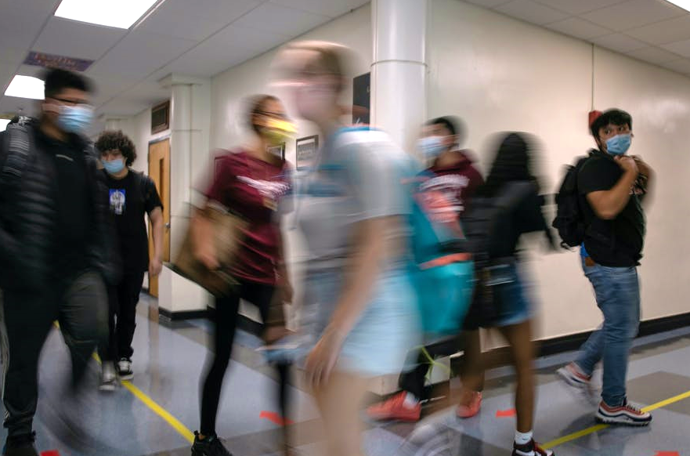
Reveals
The
Disparity
Asians are 18 times more likely to score excellence on 8th-grade math
Asians are 22 times more likely to enroll to STEM Magnet School than Black
22X
Asian are 6 times more likely to enroll in top CS programs in Illinois
18X
20X
White are 8 times more likely to find a tech job than Black
The Gap btw the
best and worst
16X
#x evaluates the gap between the ethnic groups
with the best and the worst stats.
Example: 4X in 4th-grade math proficiency
indicates the proportion of Asian
students proficient in 4th-grade
math is 4 times greater than
that of Black students.
8X
8X
TBC
5x
6X
6X
6X
4x
4X
5X
3X
4X
2X
1X
TMD
4th Grader Math Proficiency
TOP 3 Tech Jobs Demographics
4th Grader Math Excellence
TOP 11 Tech Jobs Demographics
8th Grader Math Proficiency
8^{h} Grader Math Excellence
Stem Magnet School Enrollment
18-24 years old enrollment at Illinois University
CS degree enrollment at Illinois University
SAT Math Proficient
CS degree enrollment at TOP 3 University in Illinois
SAT Math advanced
CS degree conferral at TOP 3 University in Illinois
CS degree persistence at TOP 3 University in Illinois
STEM magnet Highschool Enrollment
CS degree conferral at Illinois University
CS degree persistence at Illinois University

Slide 36


Slide 37
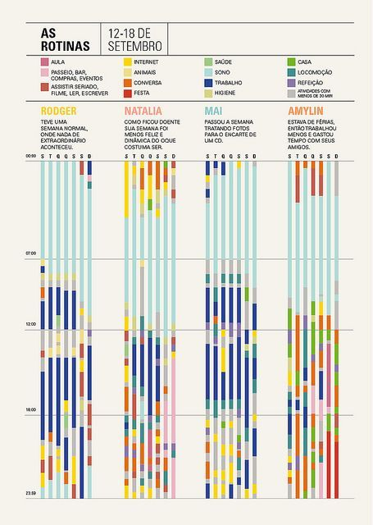

Slide 38


Slide 39
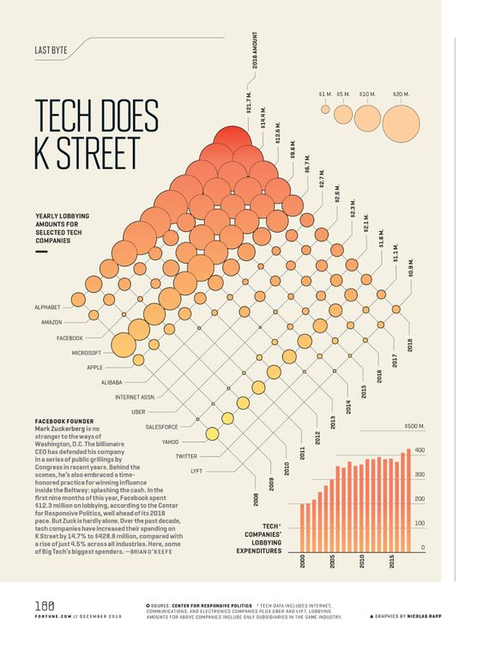
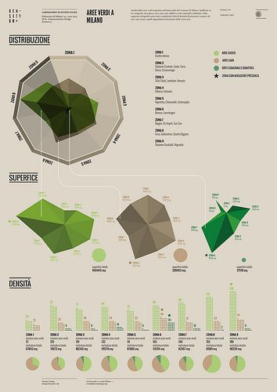

Slide 40




Enrollment

Slide 41


